Slide 1
Report for Community Council
23rd May – 17th June

Slide 2
Numbers:
We have worked with 210 young people
This equated to 420 learning hours
This happened at 24 different activities

Slide 3
Football Coaching with ICT Youth Development
We have been working with ICT Youth Development since last summer,
Young people are learning about ball control, passing skills and shooting,
The improvement in the young people is amazing,
The coaches Craig & Scott enjoy coming to Cromarty each week to deliver football coaching.
The ICT football coaches have been skilling up our young leaders teaching them new skills and games

Slide 4
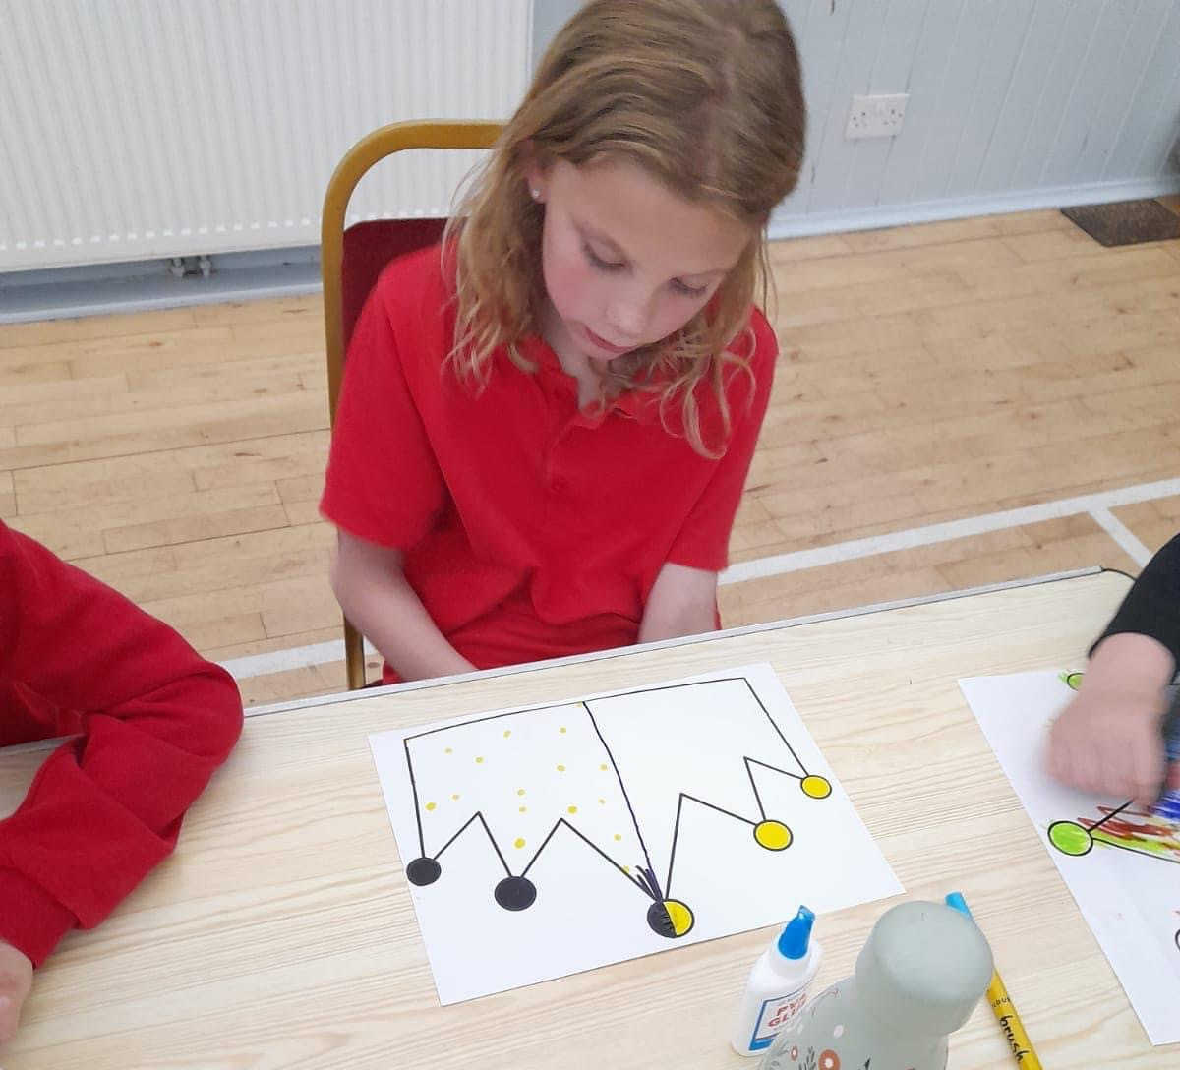
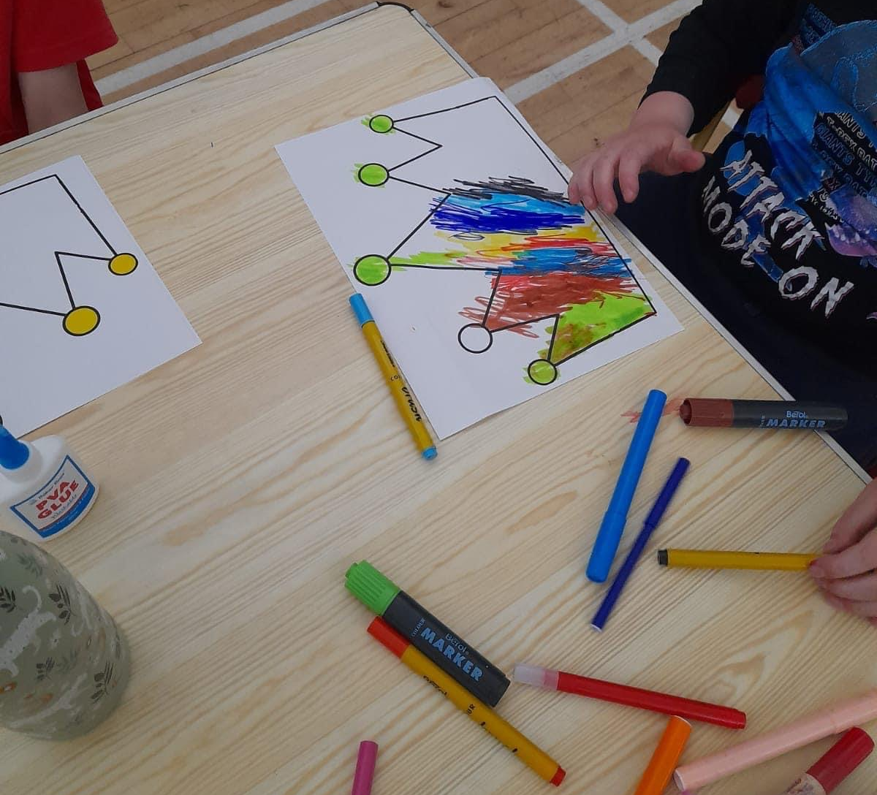
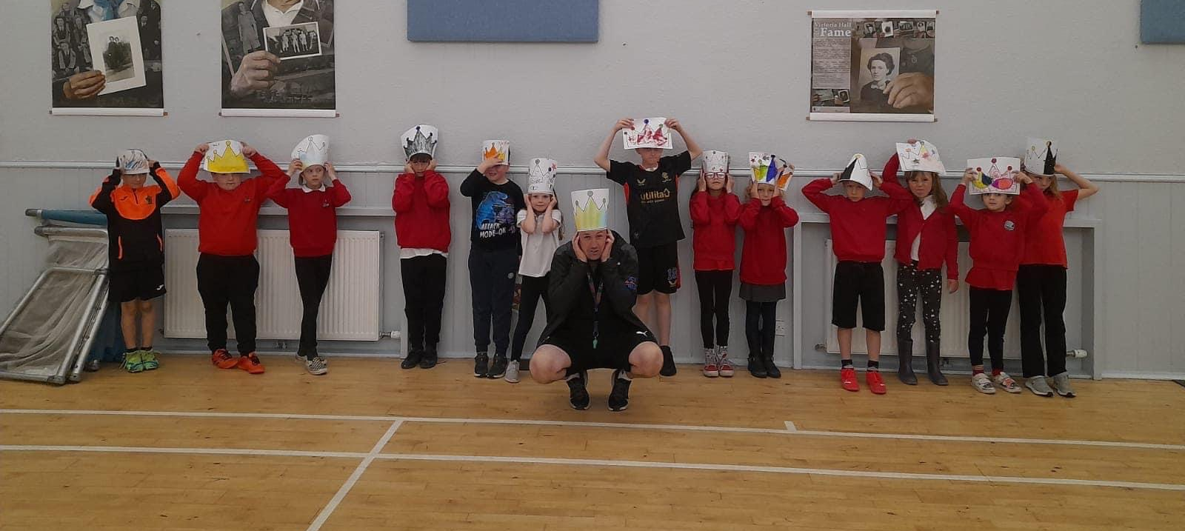
Crown Designing at Junior Youth Café
On the lead up to the Queens Platinum Jubilee celebrations, Young people were given a crown template and asked to design a crown they would wear, some of the crowns were amazing.

Slide 5
Queens Platinum Jubilee Community Celebration
Well Thank you ,thank you ALL so much for joining us at our Queens Platinum Jubilee Community Celebration s a great night for our Community to Reconnect and celebrate, many young people helped in the planning and organisation of our night volunteering ,baking , setting up 🆙, doing activities and not least of all performing duties . A buffet fit for Kings , QUEENS and everyone in between was enjoyed by all .
To the midnight crew Wanda Fraser , John , Michelle, Kath , Joanna , Vicky our youth crew who served , cleared and packed away Thank you 🙏 all .
Dom for the ever lasting Face painting session 🖼 young ones Loved it Smiles were for FREE Special mentions to Alistair Fox 🦊 on pipes for playing Diu Regnare a personal tribute written by piper Stuart Liddell To Tilly Grist for lighting our Beach Beacon whilst at the same time Inverness Acapella choir sang It is a Life filled with Grace which was specially composed for the Queens Platinum Jubilee .
CCRC and our Youth rowers 🚣‍♀️🚣‍♀️
Wild Swimmers – Cromarty Mermaids 🧜‍♀️
Cromarty Fire 🔥 Brigade
ICT Football ⚽️ 🥅 youth section
Cromarty Tennis 🎾 and Sports club
Cromarty Care Project and Trikes and Pilots Evoventures 🐬- beautifully decorated boats and drive bys C @ DCC 🙏
Cromarty Primary School 🏫
Fortrose Academy 🏫
Claire Barber for our Amazing poster 🖼
Please send me any photos you would like shared 😎
#PlatinumJubilee
#teamworkmakesthedreamwork

Slide 6
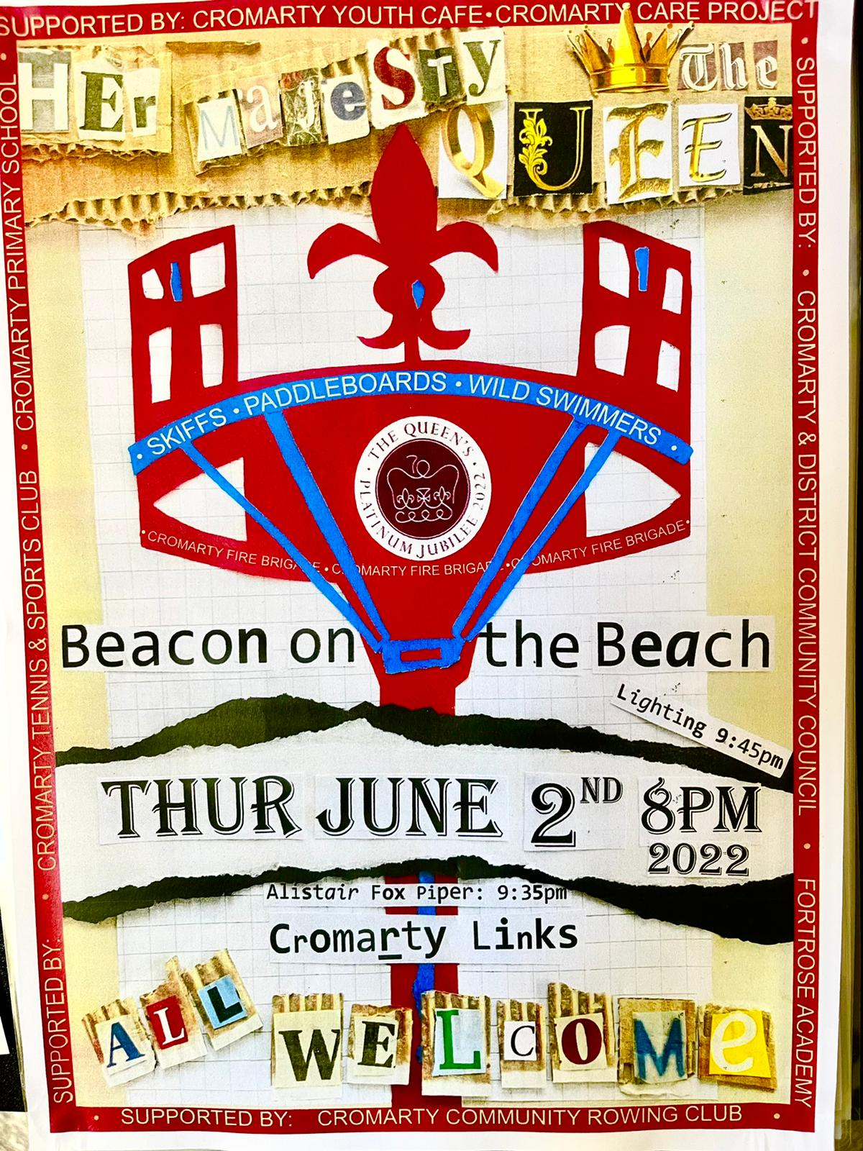

Slide 7
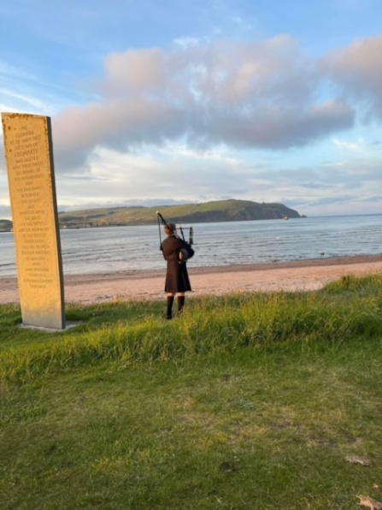
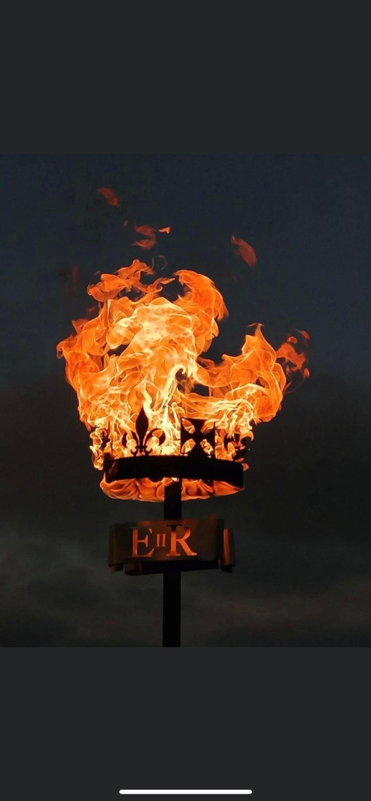
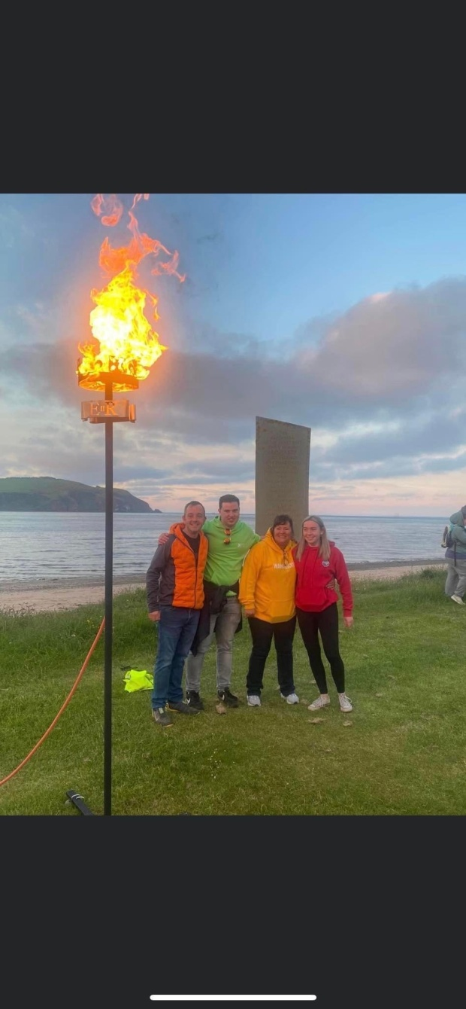
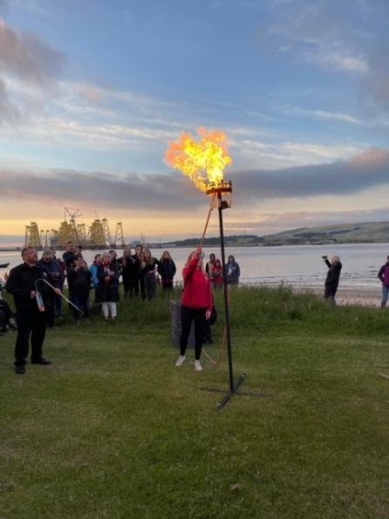

Slide 8
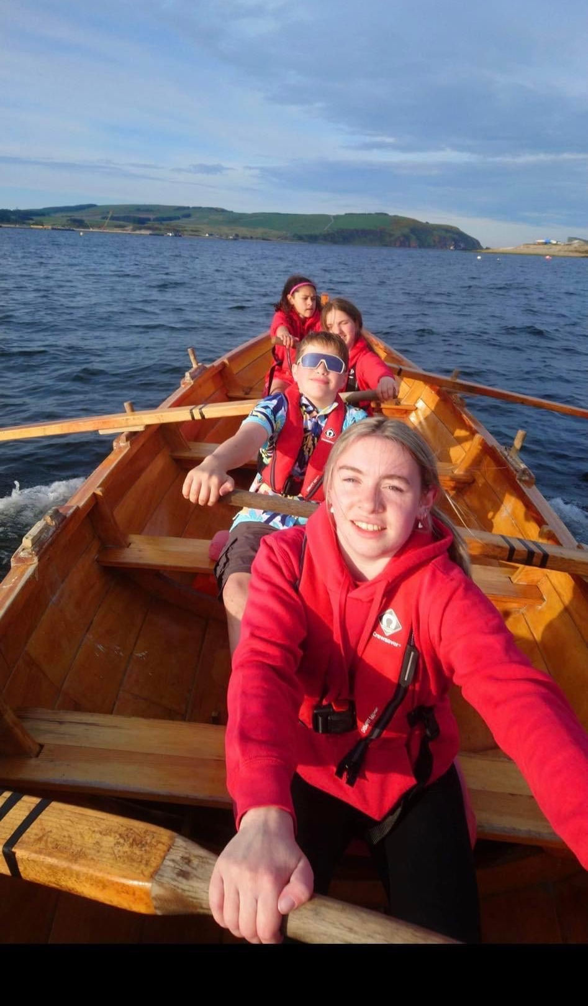
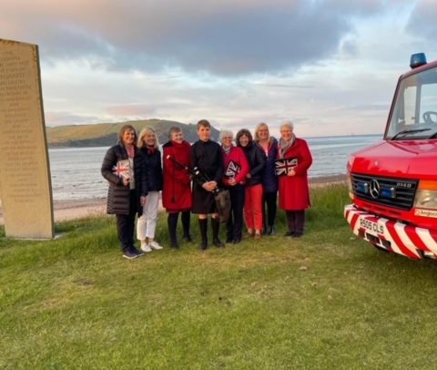
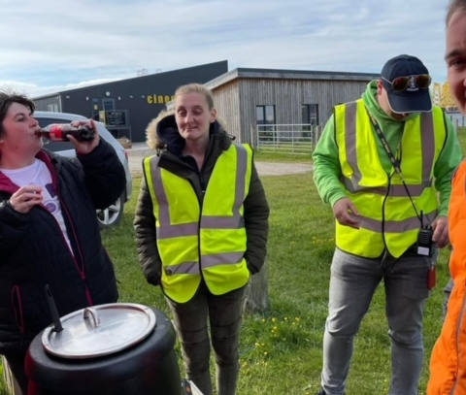
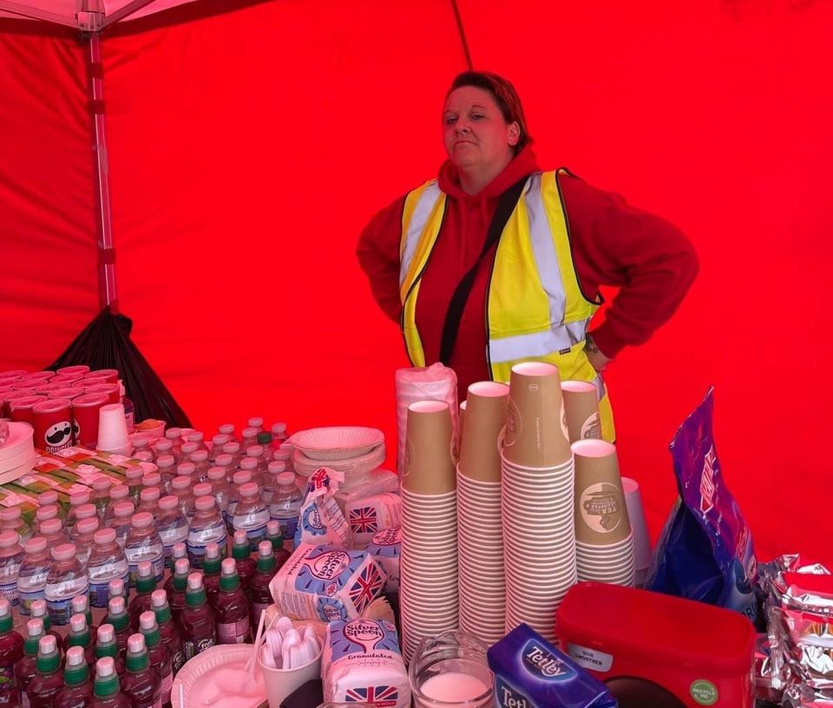

Slide 9
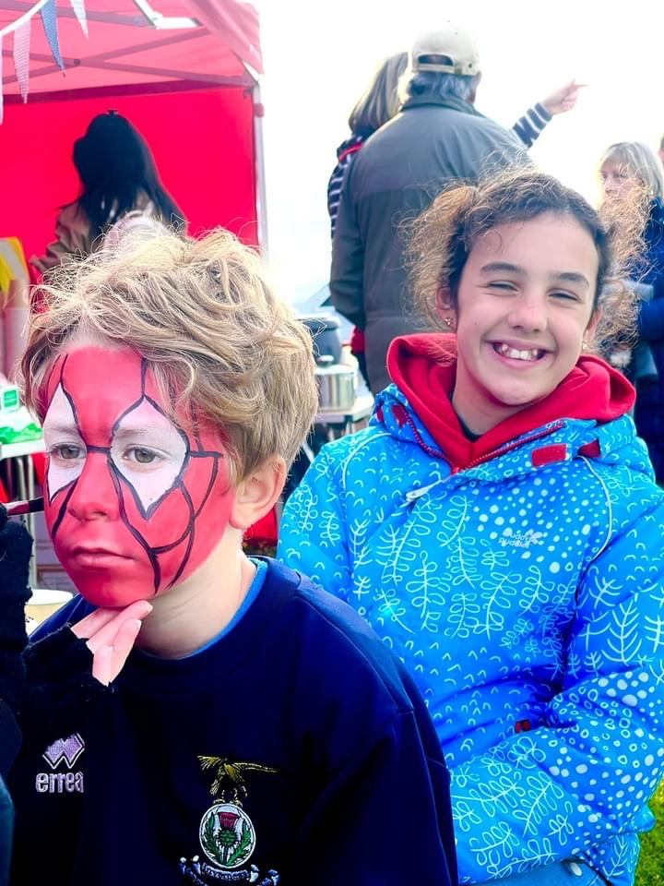
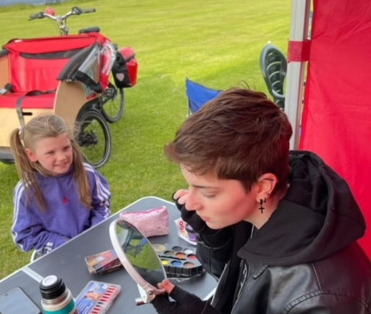
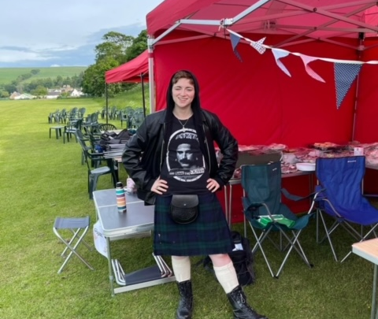
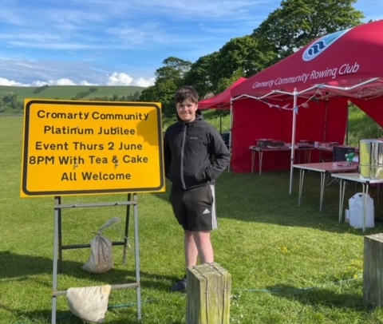
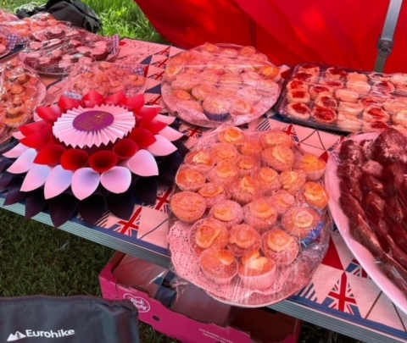
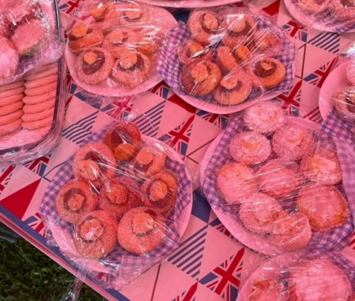
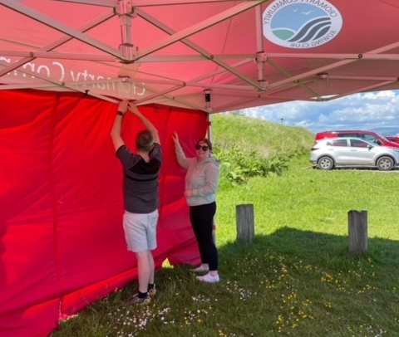

Slide 11
Youth Café
Each week at Junior Youth Café we provide different activities
Young people are consulted as to what activities they would like to see happen
Young people created their own code of conduct in agreement with staff

Slide 12
Walk & Talk
Part of Senior Youth Café we often go for a walk around the town, this helps with young people well-being, stopping loneliness and isolation
One of night we went to collect chairs to set up for the Queen’s Platinum Jubilee celebration, young people found this highly entertaining, carrying chairs on their head.

Slide 13
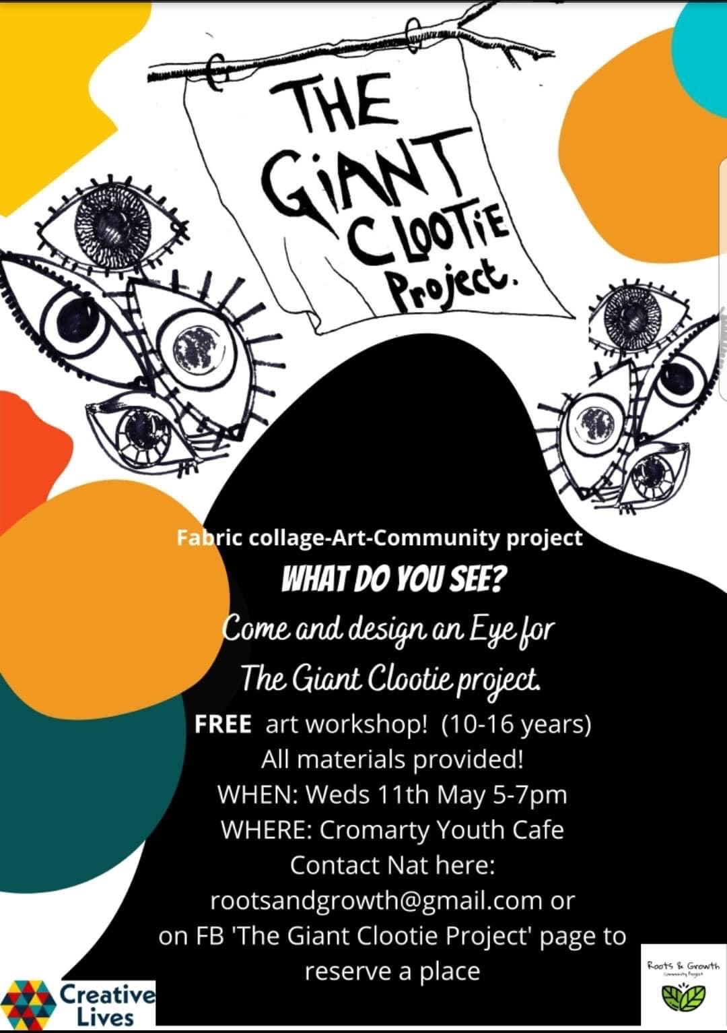
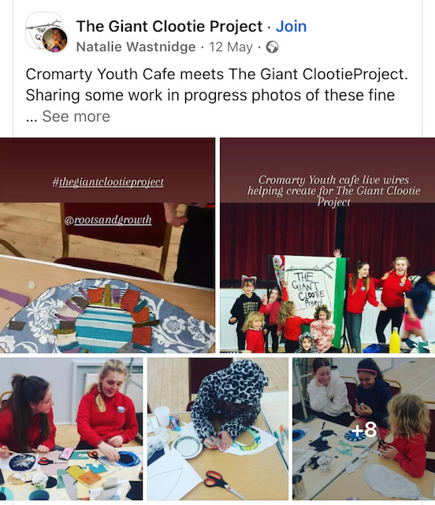
The Giant Clootie Project with The Roots & Growth Project

Slide 14
What is the Giant Clootie Project
Cloth tells a story. Just as the cloots hanging on the branches at the Clootie well are believed to help recovery from illness, the cloots that you create will be offerings and suggestions as to how we can build and create a better future.
The Giant Clootie Project is a chance to be part of a large community art piece that is made up of many individual parts that depict your ideas about renewal, regeneration, reuse, rebirth and the climate emergency.
The Giant Clootie will become a record of our thoughts and feelings at this moment in time.
Now more than ever, we have the opportunity to emerge again, gather and create as a community

Slide 15
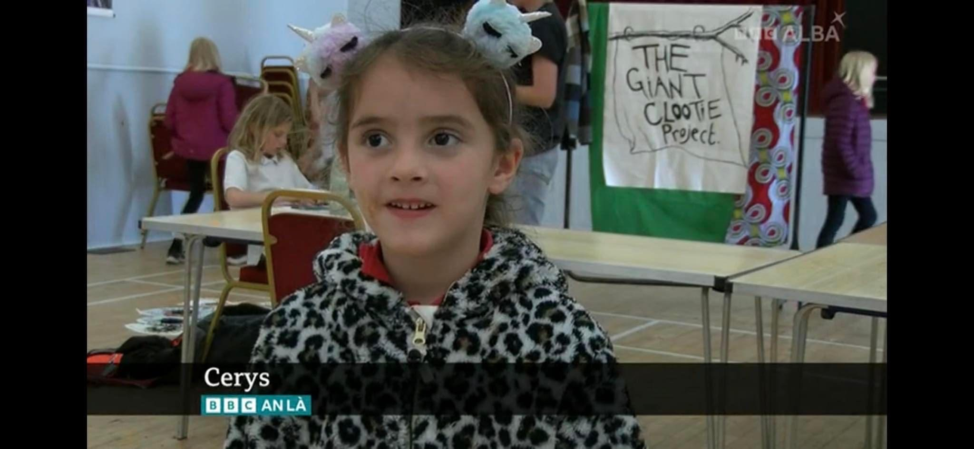
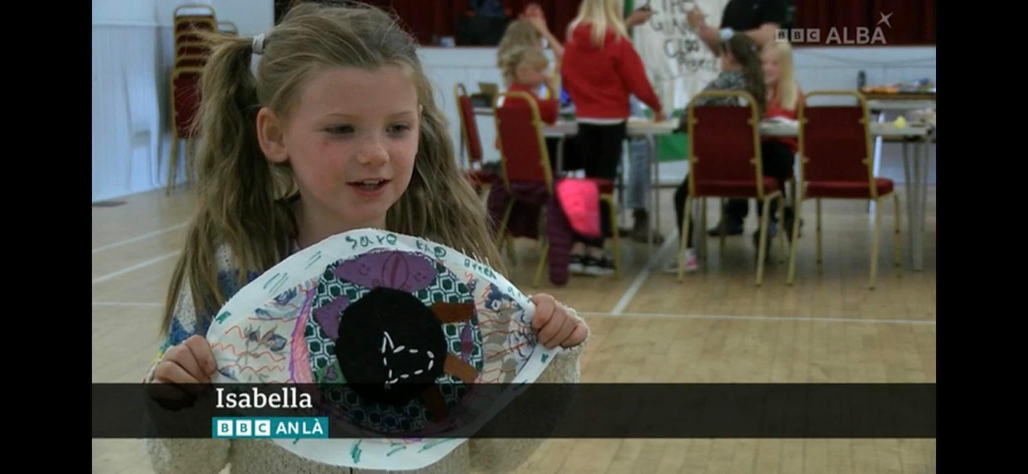
Roots & Growth – Giant Clootie Project
BBC Alba were in contact with Wanda about doing a piece about the project. Wanda Fraser and young people were interviewed by BBC Alba about the project, this was aired on Sunday 19th June at 6.15pm

Slide 16
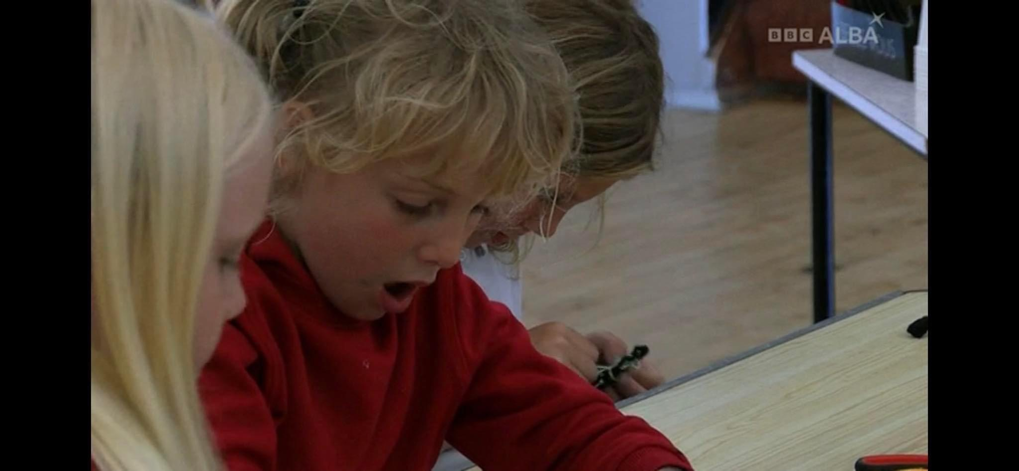
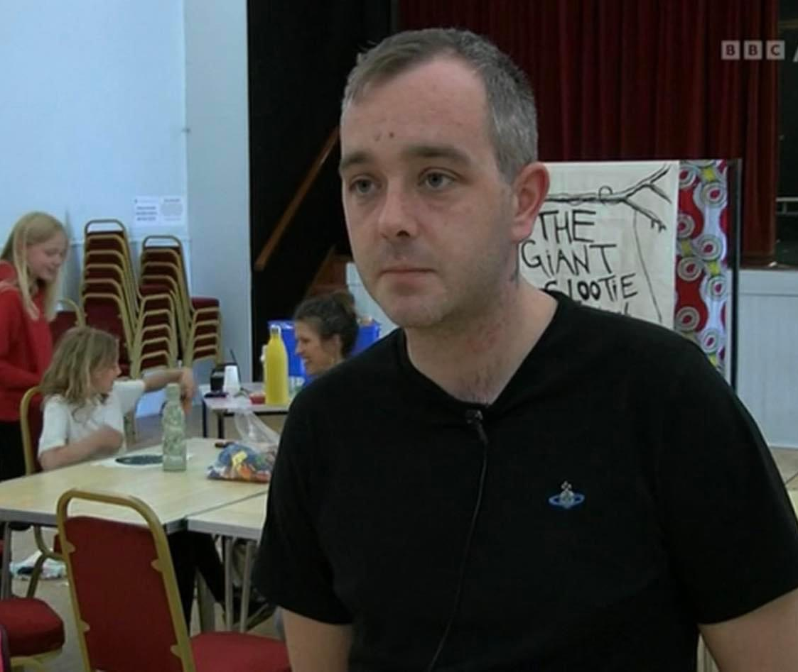
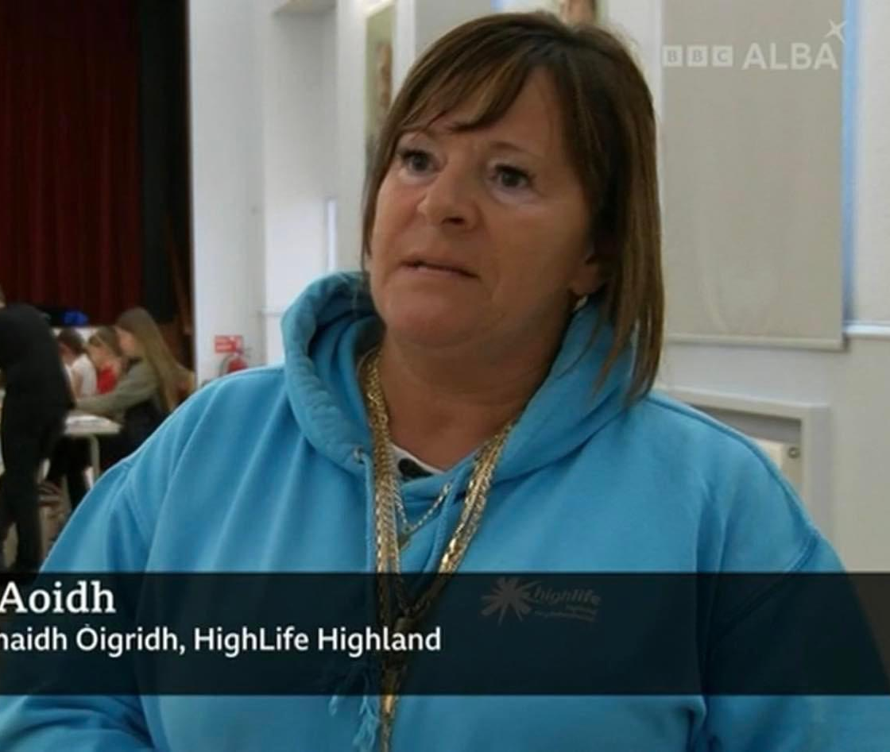
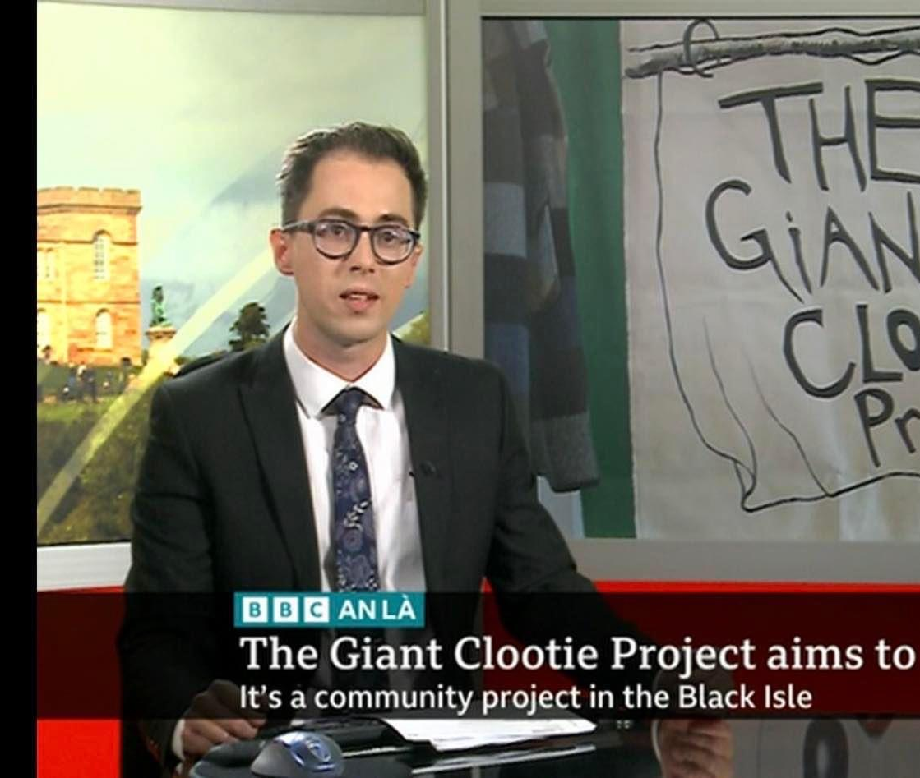
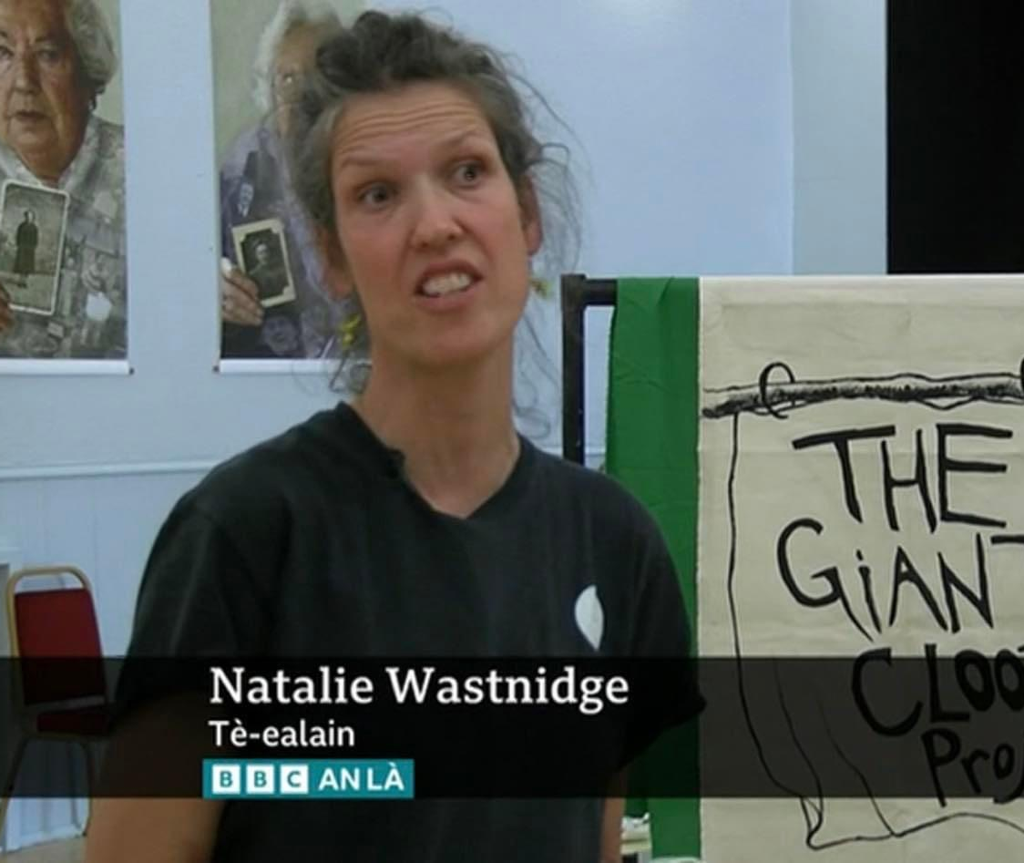

Slide 17
Food Hygiene Level 1, 2 & 3
With a little bit of funding from the Scottish Government, young people have been able to take part in Food Hygiene courses at various different levels.
Young people have been working their way through the courses, and have been learning about good hygiene, and correct ways to store food.
This will enable young people to cookwell, Bakewell , Eatwell and in turn Livewell.

Slide 18
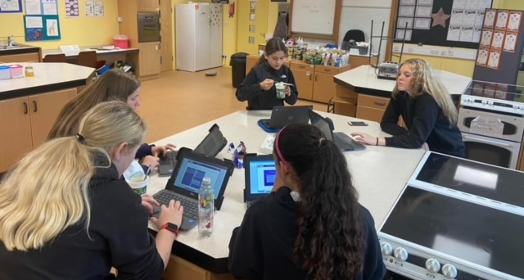
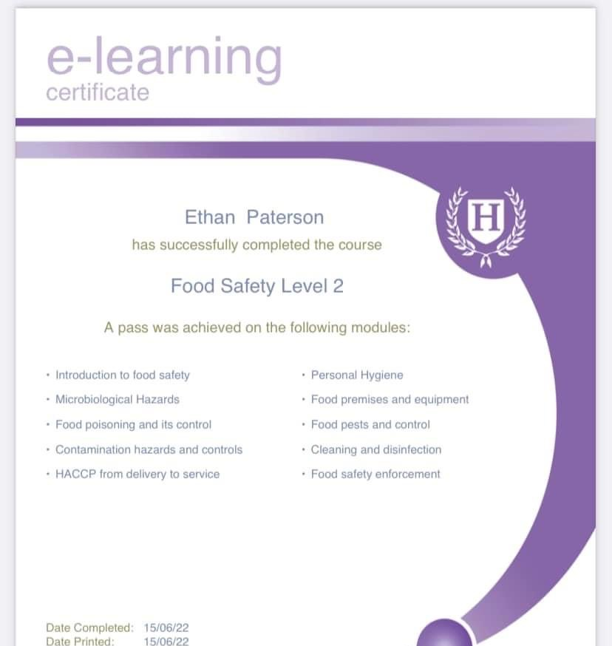
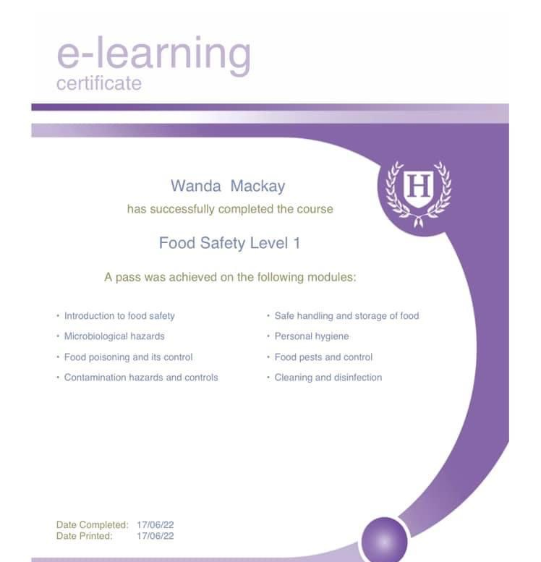
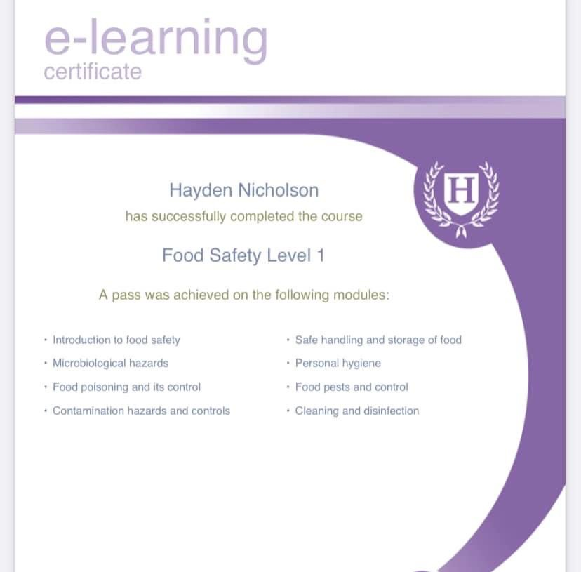

Slide 19
LOST: A Climate Action Exhibition workshop
Great to take part in - LOST: A Climate Action Exhibition workshop Artist Julia Barton is continuing the COP26 Climate Crisis story with LOST, an immersive Climate Action Exhibition at Eden Court (May 15 - Jun 12) that aims to show how plastic pollution directly contributes to our Climate Crisis. The exhibition will feature a collection of 18 #LitterCUBES plus a film projection that will play throughout illustrating the dripping-away of 100 litres of oil, visually representing the lost energy embodied in the #LitterCUBES.
The practical making sessions which took part around harbours, on beaches, in boat sheds, colleges and schools provided multiple, perfect opportunities to discuss the issue of Plastic pollution, its use of fossil fuels, the climate crisis, recycling, and climate actions we can take and share with each other in a relaxed way.
I am looking forward to showing my LOST exhibition and to inviting the Highland community to join me in two free interactive Climate Action events focusing on RECYCLING in the Highlands with colleagues from Plastic@Bay and Green Hive and making alternative sustainable plastics out of seaweed! Sent from my iPhone

Slide 20
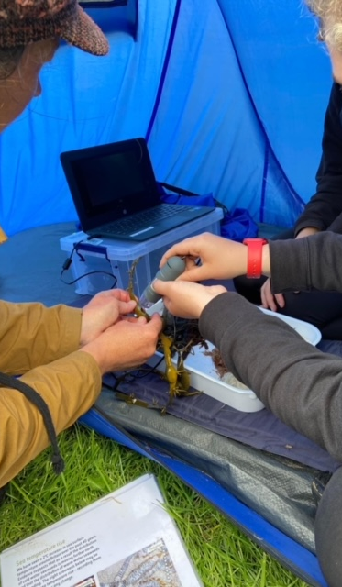
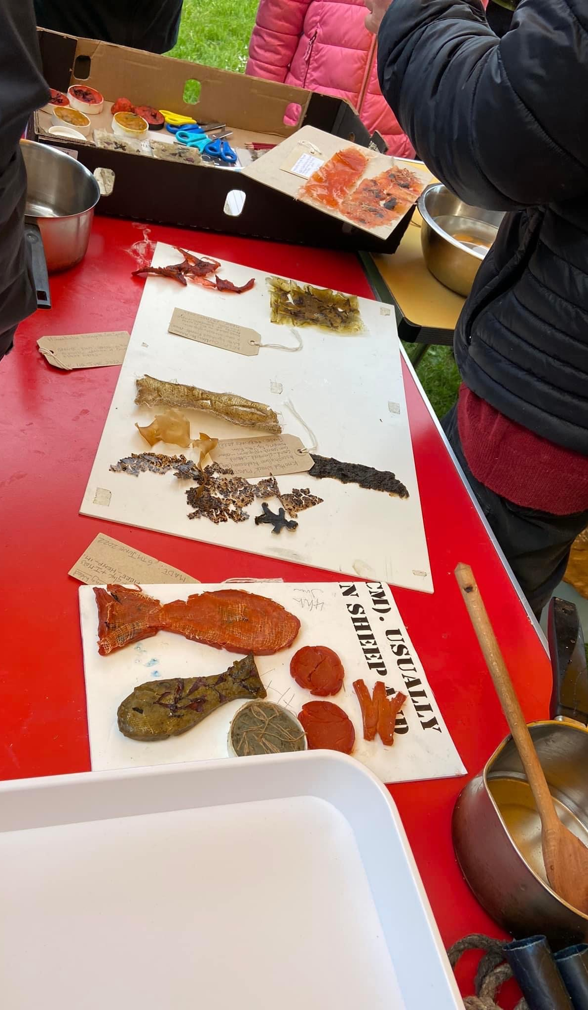
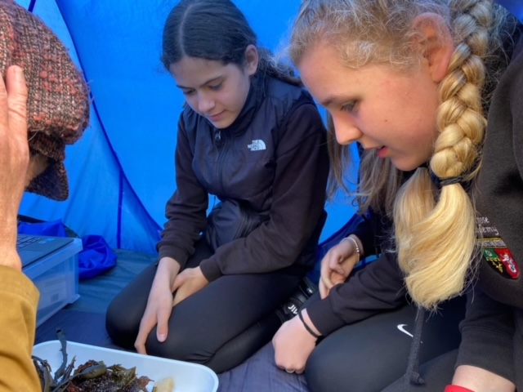
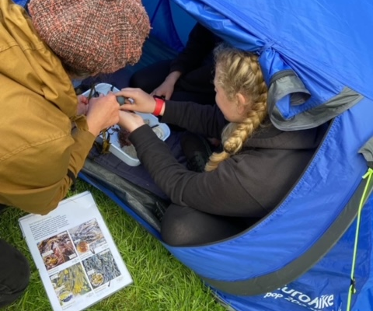

Slide 21
Multi-Sports
Every Monday night, this is led by Young leaders
The young leaders are working toward Their Choose Lead Level 4 with High Life Highland
Young leaders plan , deliver and then review the session
The plan is always delivered around what young people want,
Each week young people are playing new games and are working on different skills, such as team work, throwing and catching, & communication skills

Slide 22
#Foodtherapy
At every activity we offer food whether it is a 1-1 or group session there is food provided at each activity.
We are all to aware of the Food or Fuel poverty a number of our families are in.
Young people are consulted as to what they would like to make / eat at each activity.

Slide 23
1-1s
Emotional Checks in
Cookwell / Bakewell
Building confidence
Supporting YP to take part in driving theory test
Supporting YP to take part in school subjects
Listening to young peoples fears about leaving school and transitioning in the world of work, a number of young people are feeling anxious about leaving school as school in there safe zone and now they are stepping out of it.

Slide 24
Trip to Inverness Cinema
One of the senior Youth Café sessions was to Inverness Cinema to see the new Top Gun Maverick Movie,
Young people requested if they could go to this film. All the young people absolutely loved the cinema experience and enjoyed watching the film.
Lady Gaga - Hold My Hand (From “Top Gun: Maverick”) [Official Music Video] - YouTube

Slide 25
Cookwell / Bakewell
Cookwell Bakewell happens at each session,
Young people plan a menu and then support with making it.
On the lead up to the Queens Palatium Jubilee Ethan Paterson volunteered his time to bake, Gingerbreads, Shortbread, Tea Loafs, Scones, Cupcakes for every person who attended the event,
Young people have been learning how to make jam using local fresh fruit
EVERYONE Loved Ethan's Baking

Slide 26
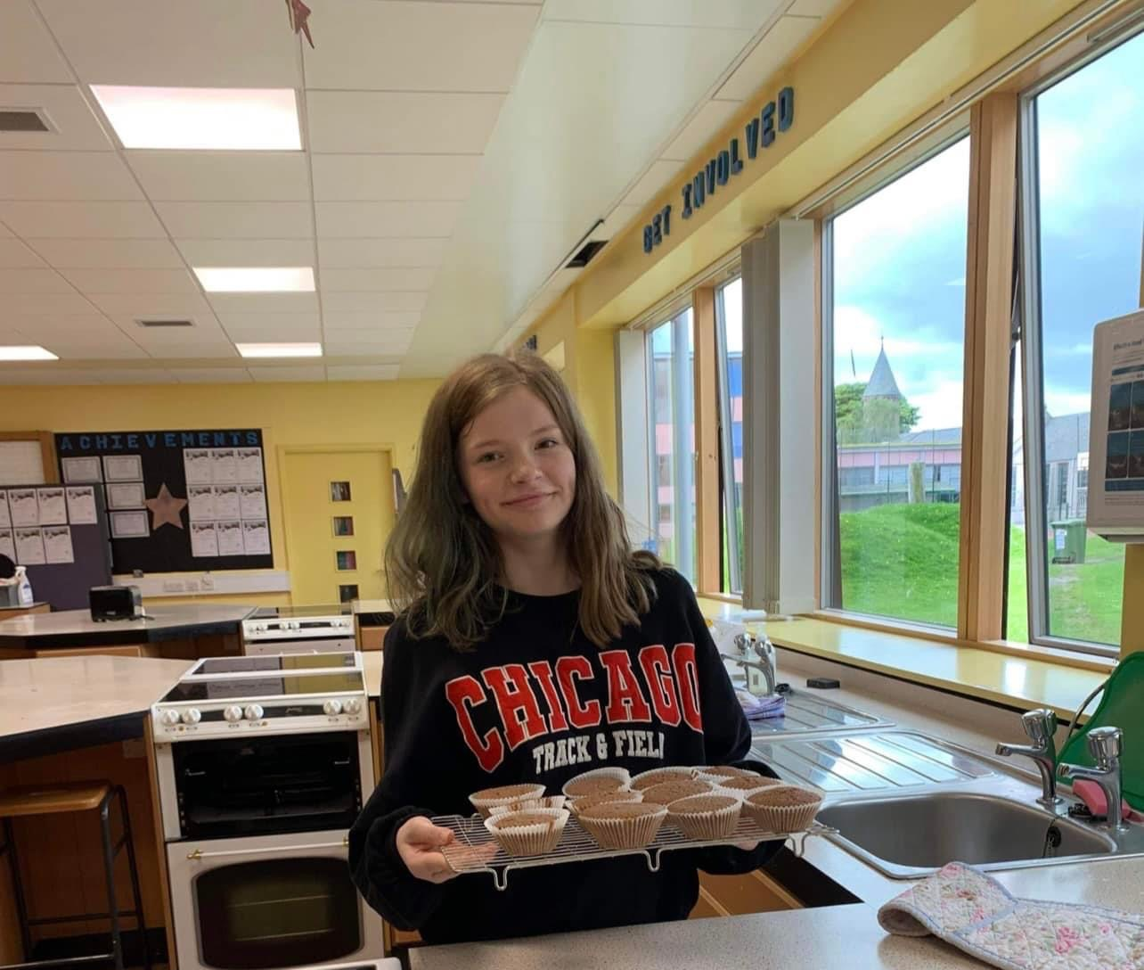
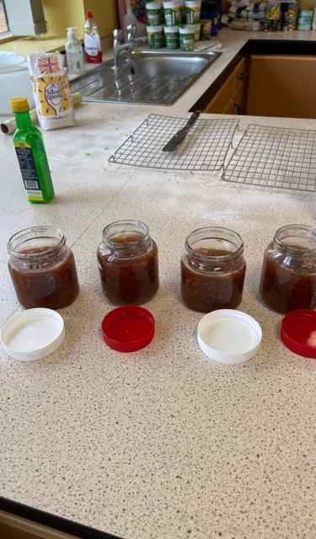
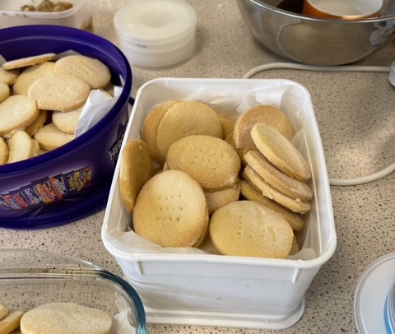
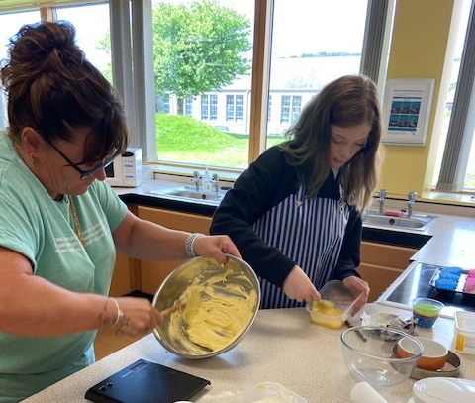
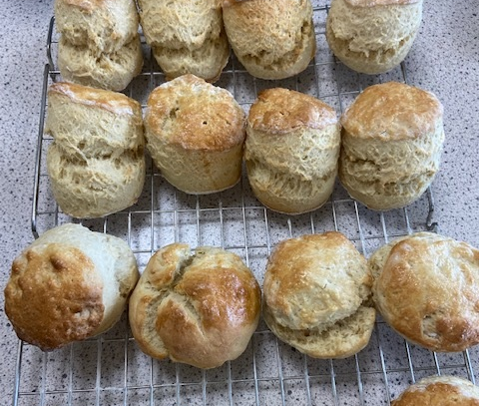

Slide 27
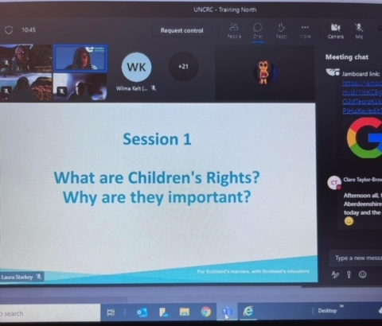
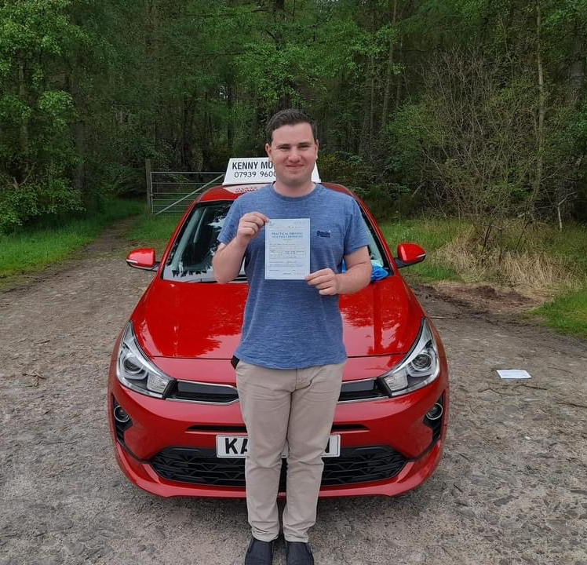
Staff Development
Wanda and Fraser attended 2 training session’s with UNCRC& Education Scotland about why the rights of a child are so important.
John Munro Passed his driving Test ☺

Slide 28
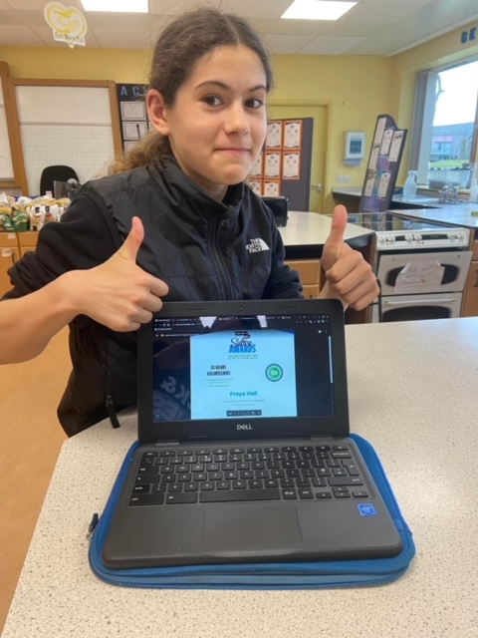
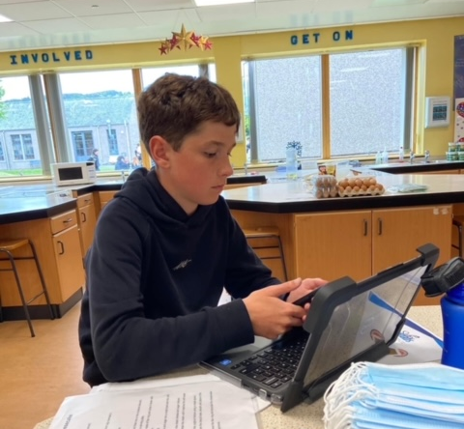
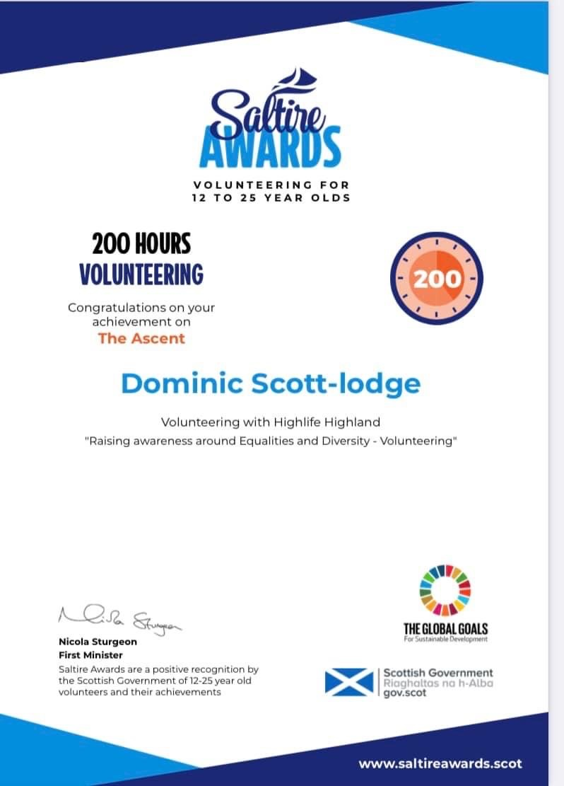
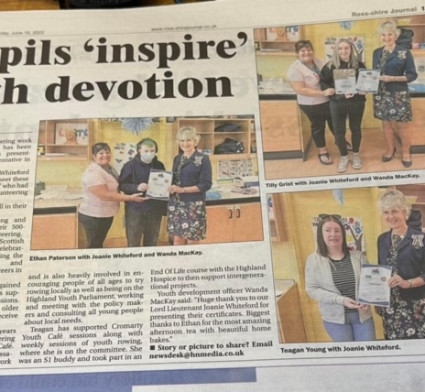
Saltire & Leadership
Over the last month, we have been busy updating young peoples, Saltire Diaries and leadership hour logs,

Slide 29
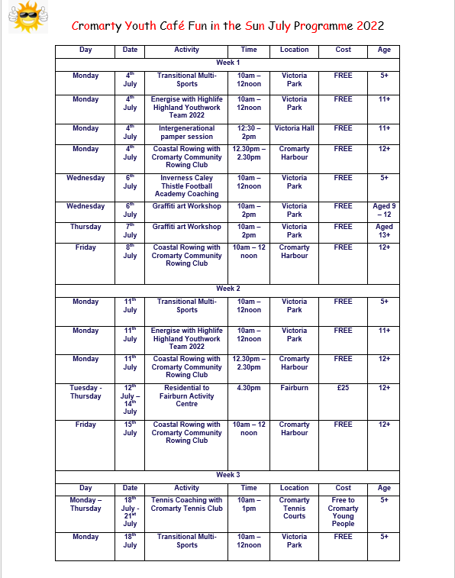
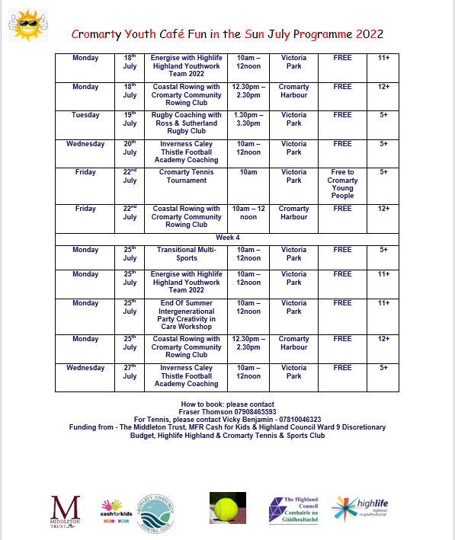
Summer Programme 2022

Slide 30
Thank You for Reading

